Slide 1
Java/Android Project
Food Tracker
Ben Bowen - CodeClan E17 - Jan 2018

Slide 2
Brief
Food Tracker
Goal: Practice OO and UI design with what we learned in Java / Android weeks
MVP
You are required to write an Android app that allows a user to track the food they eat. Users should be able to enter what they eat and when (date/time) and for what meal.
Project Extension
The app should show the user a record of what they have eaten over a given period e.g. In March I drank 23 cans of Irn-Bru.

Slide 3
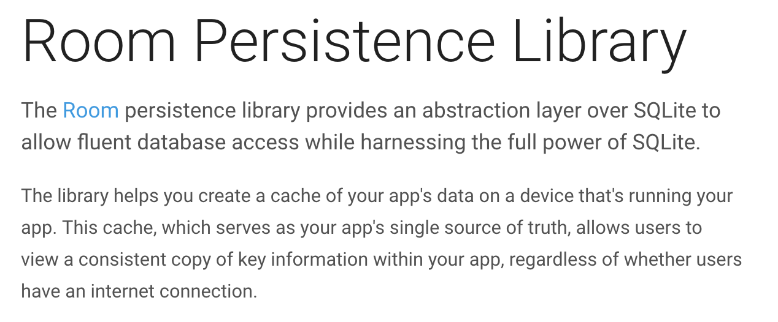
From the Android docs:

Slide 4
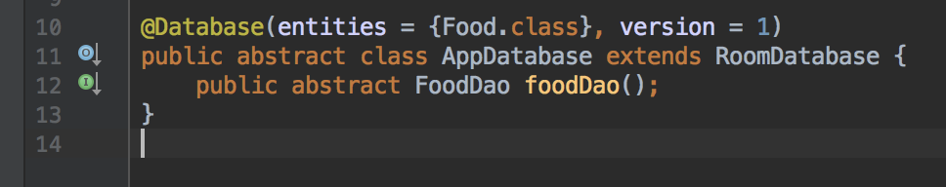
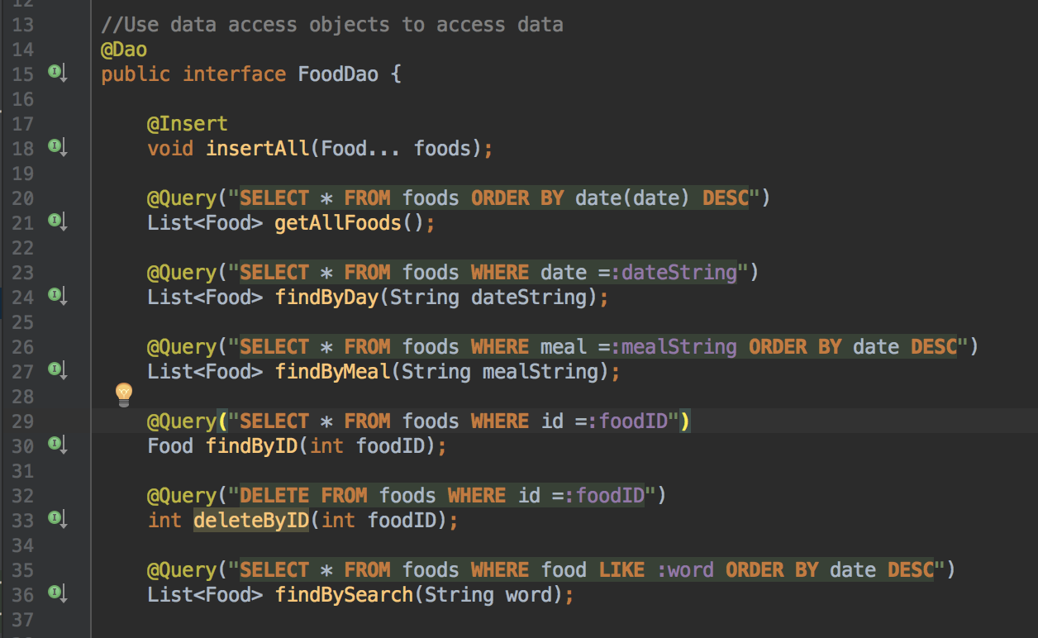
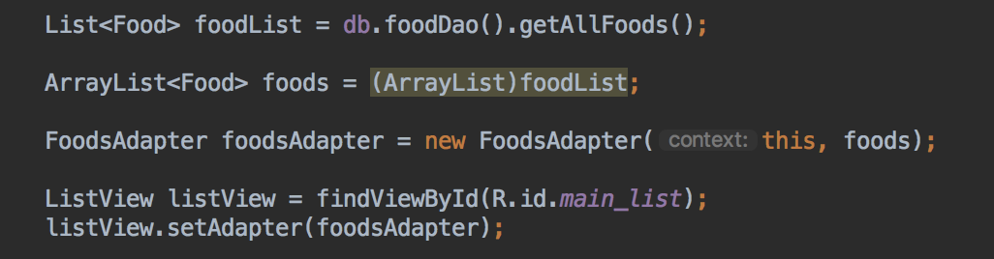
Using the Room library provided by Android Studio

Slide 5
Demo of app

Slide 6
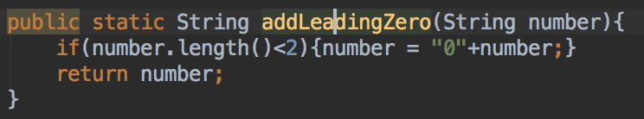
Problems with dates and databases
SQLite can’t take date as a data type.
I decided to store it as yyyy-MM-dd, so it could be sorted, but preferred it to be displayed as dd/MM/yyyy…
But: “2018-1-10”
“2018-1-9”
But “2018-01-10” comes after “2018-01-09”.
Function to put in missing zeroes for one digit months and days:

Slide 7
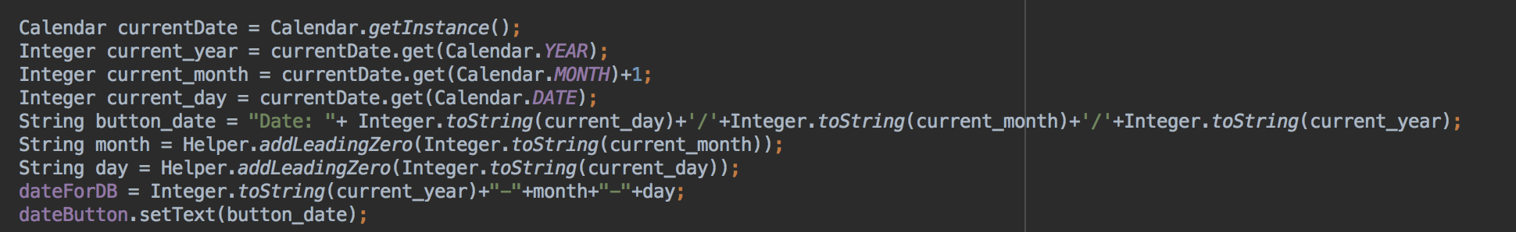
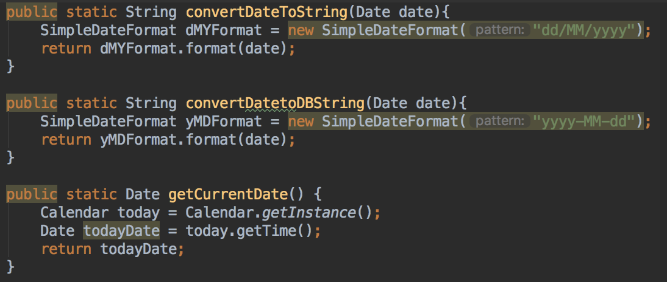
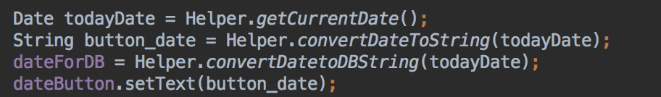
Refactoring
To get the current date to appear on the date dialog button before it is clicked:

Slide 8
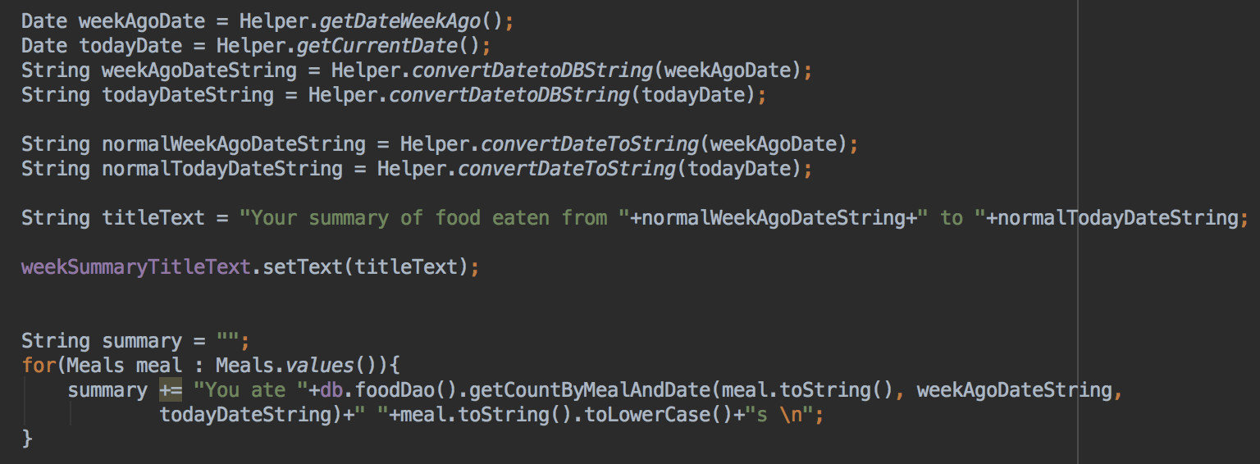

Slide 9
Things I learnt
- using Stack Overflow / Android docs
- dealing with converting string to dates and back in java
- patience dealing with android studio e.g. layout, getting rid of keyboard, non-selectable item showing in spinner etc.
Things I spent time on
- date picker dialog
- date formatting
- spinners (drop-down list)
- dealing with converting string to dates and back in java
Things I would have liked to have done
- more Java e.g. with game logic
- fragments and recycler view in Android
- have parent class for menu
- more database stuff
- planning with trello etc.

